Slide 1
Expectation Maximization Algorithm
Bhuvaneshwari Patil

Slide 2
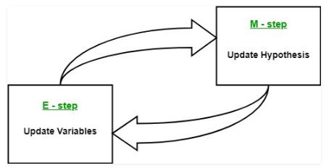
Two steps in EM algorithm
The expectation maximization algorithm enables parameter estimation in probabilistic models with incomplete data
Given a set of incomplete data, consider a set of starting parameters.
Expectation step (E – step): Using the observed available data of the dataset, estimate (guess) the values of the missing data.
Maximization step (M – step): Complete data generated after the expectation (E) step is used in order to update the parameters.
Repeat step 2 and step 3 until convergence.

Slide 3
Algorithm Steps
Initially, a set of initial values of the parameters are considered.
A set of incomplete observed data is given to the system with the assumption that the observed data comes from a specific model.
The next step is known as “Expectation” – step or E-step.
In this step, use the observed data in order to estimate or guess the values of the missing or incomplete data.
It is basically used to update the variables.
The next step is known as “Maximization”-step or M-step.
In this step, we use the complete data generated in the preceding “Expectation” – step in order to update the values of the parameters.
It is basically used to update the hypothesis.
Now, in the fourth step, it is checked whether the values are converging or not, if yes, then stop otherwise repeat step-2 and step-3
i.e. “Expectation” – step and “Maximization” – step until the convergence occurs.

Slide 4
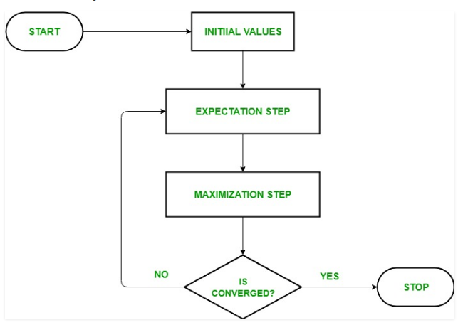
Flowchart

Slide 5

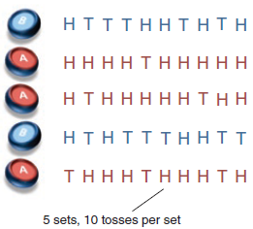
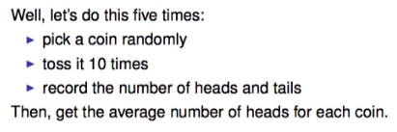
Numerical problem

Slide 6
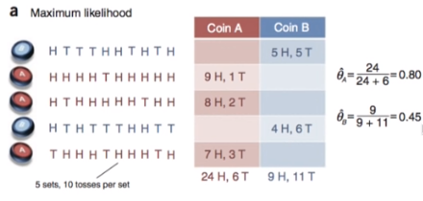
Probability estimation for HEAD

Slide 7
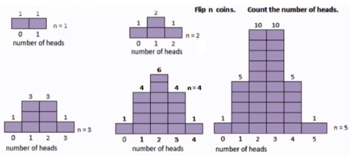
Binomial Distribution

Slide 8
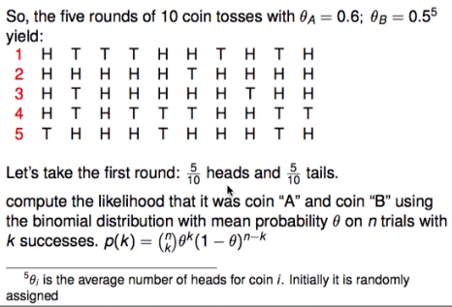
Two coins are tossed randomly and outcomes are noted. Compute the probability of getting head from each coin.
Consider coin A and B are tossed. θA and θB are probabilities of getting head by A and B respectively and (θA-1) and (θB-1) for getting tail.

Slide 9
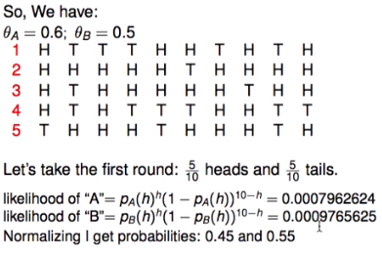
E-step - Maximum likelihood

Slide 10
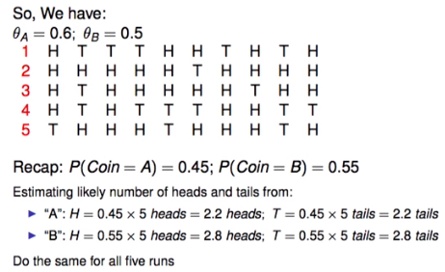
M-step - Expectation maximization

Slide 11
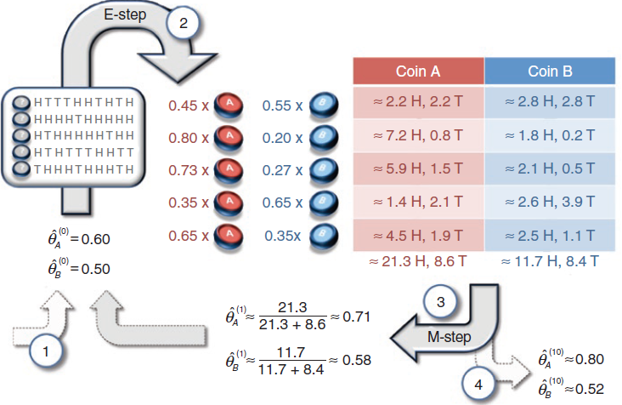
Both the steps together

Slide 12
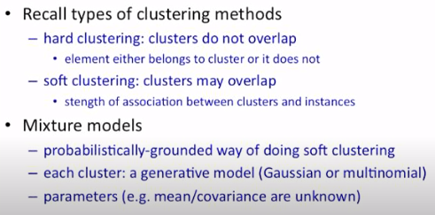
Mixture model

Slide 13

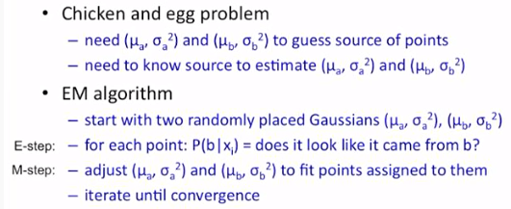
EM with Gaussian mixture model

Slide 14
Usage of EM algorithm
It can be used to fill the missing data in a sample.
It can be used as the basis of unsupervised learning of clusters.
It can be used for the purpose of estimating the parameters of Hidden Markov Model (HMM).
It can be used for discovering the values of latent variables.

Slide 15
Advantages of EM algorithm
It is always guaranteed that likelihood will increase with each iteration.
The E-step and M-step are often pretty easy for many problems in terms of implementation.
Solutions to the M-steps often exist in the closed form.

Slide 16
Disadvantages of EM algorithm
It has slow convergence.
It makes convergence to the local optima only.
It requires both the probabilities, forward and backward (numerical optimization requires only forward probability).

